Slide 1


TEAM VISIONEERS….the future is bright.

Slide 2

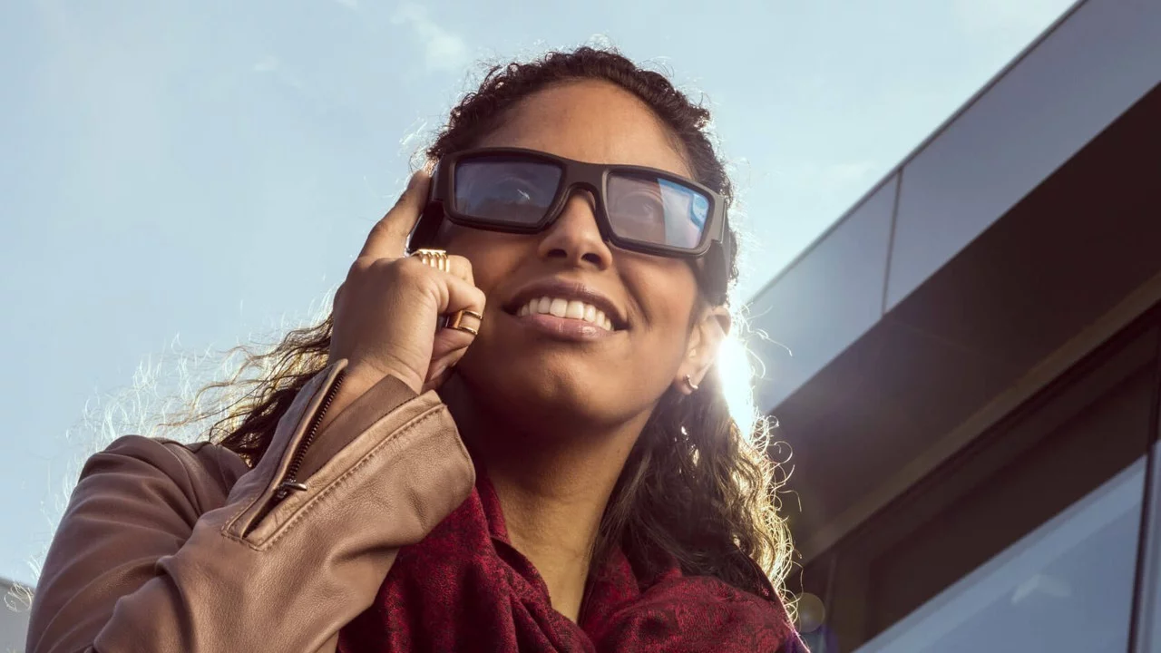
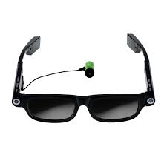

Smart Glass And A Smart Working Aid For The Visually Impaired

Slide 3
STATISTICS
Globally the number of visually impaired people is estimated to be 253 million of whom 36 million are blind
Of people over 40 years, 42 out of every 1,000 people are visually-impaired, which is about 8.3million people in Nigeria

Slide 4
STATISTICS
The major causes of visual impairment are uncorrected refractive errors and cataract and aging.

Slide 5
PROBLEM STATEMENT
The visually impaired people needs a way to read and move around without human help

Slide 6
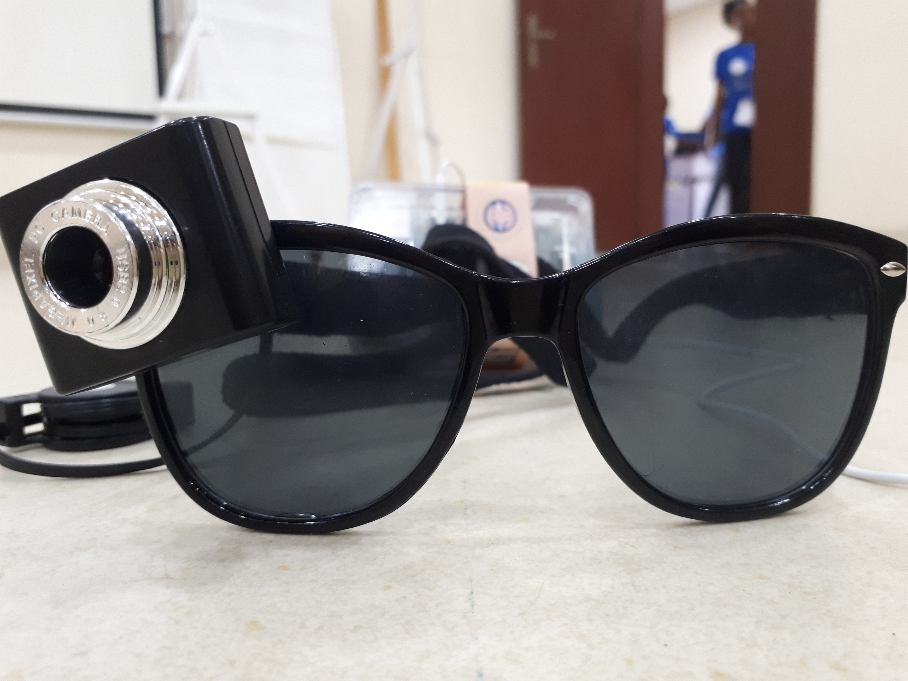
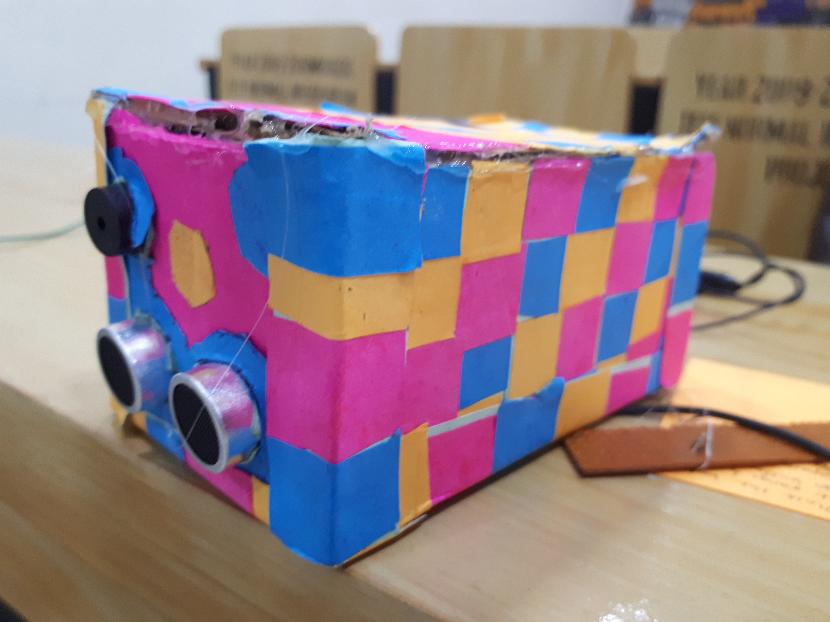
Our solution
SMART GLASS
WALKING AID

Slide 7
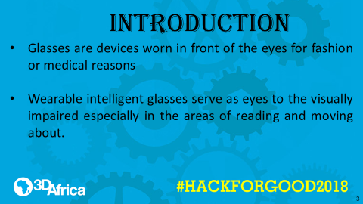

Slide 8
OBJECTIVES
This smart glass and walking aid will help the visually impaired to;
Read without human help
Sense obstacles and warns him via speech and/or vibration/buzz

Slide 9
MATERIALS
The materials used are;
An eyeglass
A USB camera
Ultrasonic sensor
A buzzer
Connecting wiresC
Arduino uno
Raspberry pi 3

Slide 10
Project plan
Method employed in the carrying out the smart glass and aid is;
Obtain the materials needed
Assembly of components on breadboard
Fabrication through stereolithography
Coding of Arduino Uno and Raspberry pi 3
Testing and evaluation of project work
Transfer of components to breadboard and coupling

Slide 11
schematics
BOOK IS PLACED IN FRONT OF GLASS
SMART GLASS CONVERTS BOOK PICTURE TO TEXT
TEXT IS CONVERTED TO AUDIO
AUDIO IS PLAYED
WALKING AID DETECTS OBSTACLE
ALERTS USERS BY BUZZING/VIBRATING
USER AVOID OBSTACLES
USER IS SAFE

Slide 12
MARKET
GLOBAL MARKET (by 2022) $6.9 Billion
- Market Insider
Sub-Saharan African Market $218 million
- Calculated from statistics

Slide 13
RESULT AND DISCUSSION
The smart glass and hearing aid is able to give eyes and movement aid to the visually impaired.

Slide 14
CONCLUSION
In conclusion, this prototype fabricated is the answer to visually impaired peoples’ prayer and is subject to improvements

Slide 15
REFERENCES
Bourne RRA, Flaxman SR, Braithwaite T, Cicnelli MV, et al, Vision loss expert group Sep 5, 2017
Nigerian Optometrists Association, 2005-2008 National blindness survey

Slide 16


